Slide 1
Finding Relevant Information of Certain Types from Enterprise Data
Date: 2012/04/30
Source: Xitong Liu (CIKM’11)
Speaker: Er-gang Liu
Advisor: Dr. Jia-ling Koh

Slide 2
Outline
Introduction
Problem Formulation
Content requirements
Type requirements
Requirements Identification
Similarity based method
Language Modeling based Method
Ranking Methods
Experiment
Conclusion

Slide 3
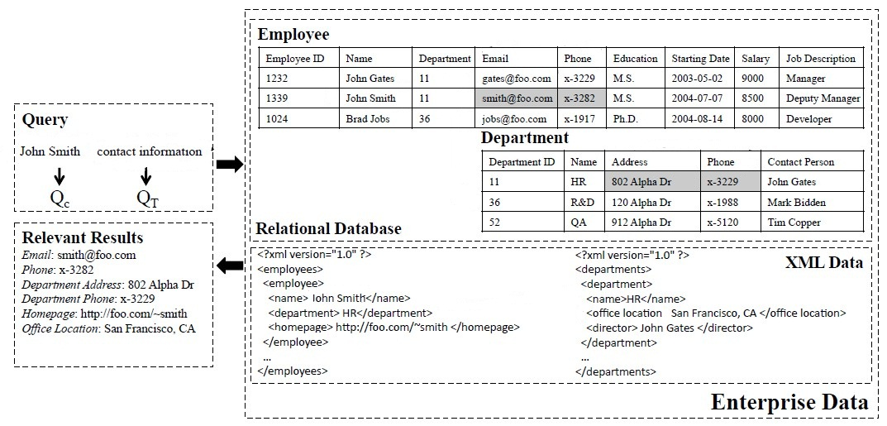
Introduction - Motivation

Slide 4
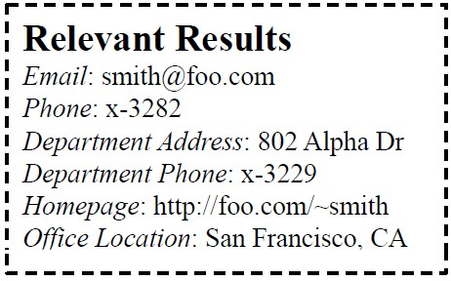
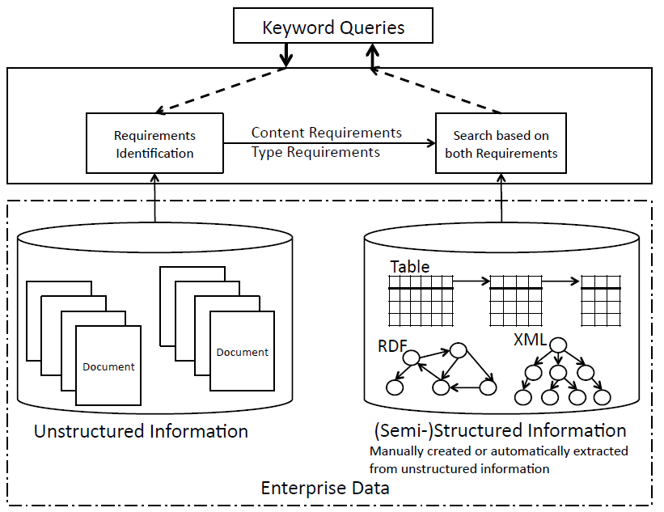
Q= “John Smith contact information”
Find relevant information
of certain types
“John Smith”
“contact information”

Slide 5
Introduction
This problem as keyword search over structured or semi-structured data, and then propose to leverage the complementary unstructured information in the enterprise data to solve the problem.
Main Step:
Requirements Identification
Search based on both requirements
Ranking Methods

Slide 6
Problem
Formulation
Requirements
Identification
Ranking
Methods
Content requirement
Type requirement
Similarity –based
Language Modeling - based
Structured Data
Semi-Structured Datd

Slide 7
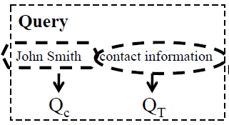
Problem Formulation
Q = (Q_{C} U Q_{T})
Content requirements
kind of information is relevant.
Type requirements
type of information is desirable.
Data Source
Content requirements
Attribute Value in tuple
Type requirements
Attribute Names
Employee
Employee ID | Name | Department | Email
1339 | John Smith | 11 | smith@foo.com

Slide 8
Problem
Formulation
Requirements
Identification
Ranking
Methods
Content requirement
Type requirement
Similarity –based
Language Modeling - based
Structured Data
Semi-Structured Datd

Slide 9
Similarity based method
Q = “John Smith contact information”
Smith
information
contact
Calculate Similarity
John
“John” , “Smith”
information
contact
Q_{C}
Q_{T}
Identify Cluster
“John” , “Smith”
“information” , “contact”

Slide 10
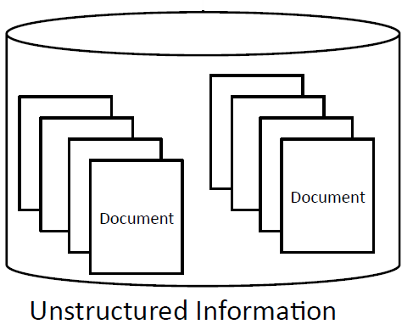
Similarity – Mutual information
P(John = 1 , Smith = 1) log $\frac{\text{P}\text{(}\text{John}\text{=1}\text{ , }\text{Smith}\text{=1}\text{)}}{\text{P}\text{(}\text{John}\text{=1)}\text{P}\text{(}\text{Smith}\text{=1}\text{)}}$ +
P(John = 1 , Smith = 0) log $\frac{\text{P}\text{(}\text{John}\text{=1 , }\text{Smith}\text{=0)}}{\text{P}\text{(}\text{John}\text{=1)}\text{P}\text{(}\text{Smith}\text{=0)}}$ +
P(John = 0 , Smith = 1) log $\frac{\text{P}\text{(}\text{John}\text{=0 , }\text{Smith}\text{=1)}}{\text{P}\text{(}\text{John}\text{=0)}\text{P}\text{(}\text{Smith}\text{=1)}}$ +
P(John = 0 , Smith = 0) log $\frac{\text{P}\text{(}\text{John}\text{=0 , }\text{Smith}\text{=0)}}{\text{P}\text{(}\text{John}\text{=0)}\text{P}\text{(}\text{Smith}\text{=0)}}$
= $\frac{150}{500 }$ log $\frac{\frac{150}{500}}{\frac{210}{500}+\frac{190}{500}}$ + $\frac{60}{500 }$ log $\frac{\frac{60}{500}}{\frac{210}{100}+\frac{310}{100}}$
+ $\frac{40}{500 }$ log $\frac{\frac{40}{500}}{\frac{290}{500}+\frac{190}{500}}$ + $\frac{250}{ 500 }$ log $\frac{\frac{250}{500}}{\frac{290}{500}+\frac{310}{500}}$
 | John= 1 | John= 0
Smith=1 | 150 | 40
Smith=0 | 60 | 250

Slide 11
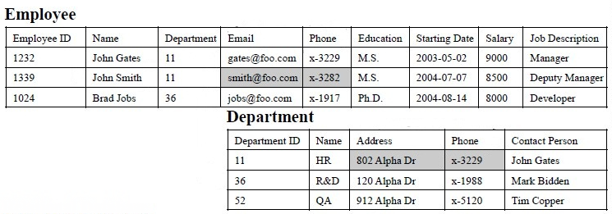
Identify Cluster
Table name + Attribute names
Calculate Similarity
Profile Document
Employee
Employee ID,
Name,
Department,
Email.
.
.
.
Higher similarity
“John” , “Smith”
“information” , “contact”
“information” , “contact”
Q_{T}

Slide 12
Language Modeling based Method
Content requirements
Type requirements
…………..........
………………...
………………..
………………..
………………..………………..
θ_{C}
P(John | θ_{C} ) = $\frac{\text{50}}{\text{500}}$
P(John | θ_{T} ) = $\frac{\text{0}}{\text{15}}$
P(contact | θ_{C} ) = $\frac{\text{ 20} }{\text{500}}$
P(contact | θ_{T} ) = $\frac{\text{2}}{\text{15}}$
Unstructured information
Total Term : 500
Q_{C}
Employee ID,
Name,
Department,
Email.
.
.
.
.
θ_{T}
Attribute set
Q_{T}
Total attribute : 15

Slide 13
Adjust Identification Result
Query term = “information”
Requirements Identification
C : Content requirements
T : Type requirements
C/C
C/T
Similarity
Based Method
Language Modeling
Based Method
T/C
T/T

Slide 14
Adjust Identification Result
Similarity
Based Method
Language Modeling
Based Method
If $\frac{\text{0.}\text{8}}{\text{0.2}}$ > $\frac{\text{0.}\text{6}}{\text{0}\text{.4}}$ then Q_{C}
If $\frac{\text{0.}\text{6}}{\text{0}\text{.4}}$ < $\frac{\text{0.}\text{9}}{\text{0}\text{.1}}$ then Q_{T}
If > then Q_{T}
If < then Q_{C}

Slide 15
Problem
Formulation
Requirements
Identification
Ranking
Methods
Content requirement
Type requirement
Similarity –based
Language Modeling - based
Structured Data
Semi-Structured Data

Slide 16
Ranking Method - Structured Data
Type Requirement
Content Requirement
A²_{T}
A³_{T}
T₁
T₂
T₃

Slide 17
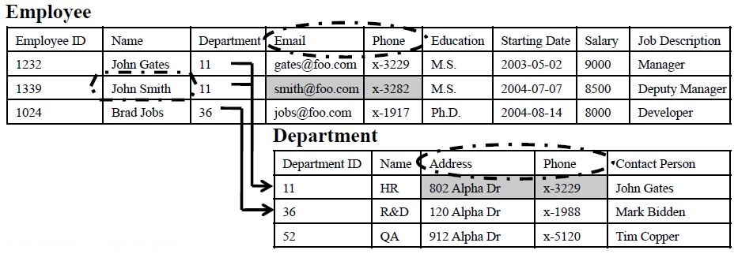
Ranking Method - Structured Data
nl(T1, T2) is the number of foreign key links between table T1 and T2
nl(Employee ID, Department ) = 1

Slide 18
Query Expansion
Q_{T} = “contact information”
Relevant attributes “Email”, “Phone” ,“Address”
not overlapped term
Attribute “Contact Person”
has one overlapped term, but it’s not a relevant attribute with regard to the query.
Q_{T} = “dimension”
“width”
“depth”
“height”
.
.
.
.
Top K

Slide 19
Ranking Method - Semi Structured Data
E_{i} = {E^{C}_{i} ,E^{T} _{i} } Entity E_{i} = “Pride and Prejudice”
E^{T} _{i} = “Novel”
E^{C}_{i} = “Pride and Prejudice, 1/28, 1983, Jane Austen”

Slide 20
Ranking Method - Semi Structured Data
N(E_{i}) is the set of all the neighbor nodes of entity
|N(E_{i})| is the size of N(E_{i}). | N(“Pride and Prejudice”) | = 1 (Node “Jane Austen”)

Slide 21
Experiment
Real-world Enterprise Data Set
The data set contains both unstructured and structured information about HP, which is referred to as REAL
Simulated Data Set
Constructed a simulated data set by choosing the Billion Triple Challenge 2009 dataset which consists of a RDF graph
Chose the Category B of ClueWeb09 collection as the complementary unstructured data
The data set is referred to as SIMU

Slide 22
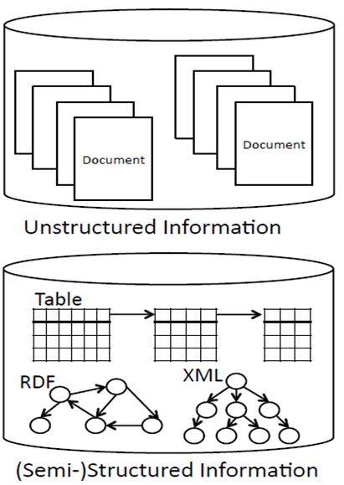
Experiment
Performance of requirement identification

Slide 23
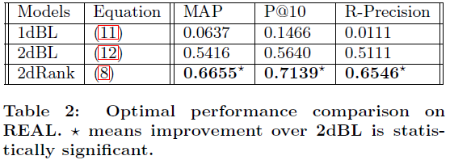
Experiment - REAL
Baseline Method
Paper Method

Slide 24
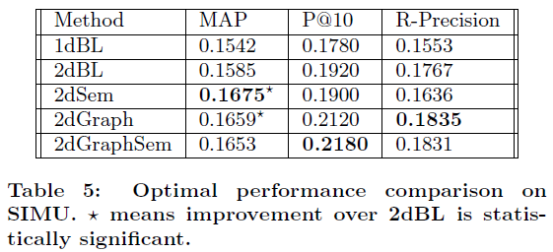
Experiment - SIMU
Baseline Method
1dBL : 1-dimensional retrieval
2dBL :
2dSem : 2dBL + Q = Q_{T-EXP}
Paper Method
2dGraph :
2dGraphSEM: 2dGraph + Q = Q_{T-EXP}

Slide 25
Conclusion
The paper demonstrated the feasibility of leveraging unstructured information to improve the search quality over structured and semi-structured information.
Ranking methods utilized unstructured information to identify type requirement in keyword queries and bridge the vocabulary gap between the query and the data collection.

